Slide 1

FML FINAL EXAM BREAST CANCER WISCONSIN
NIKITHA CHIGURUPATI

Slide 2
The problem
The Breast Cancer Wisconsin (Diagnostic) project aims to create a predictive model that, using a set of diagnostic characteristics, can accurately classify breast cancer tumors as benign or malignant.
The objective is to determine whether the breast cancer is malignant or benign

Slide 3
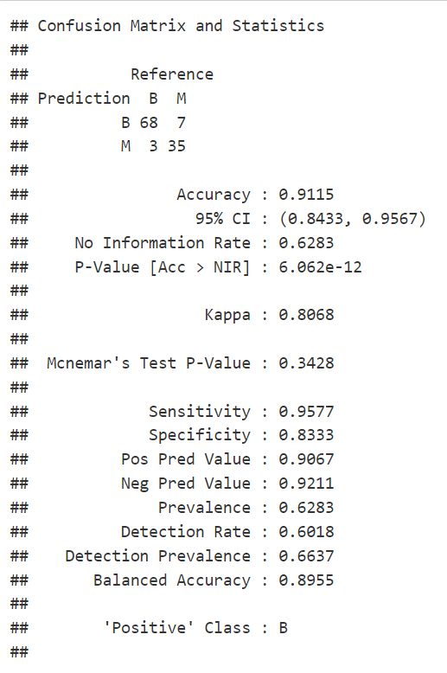
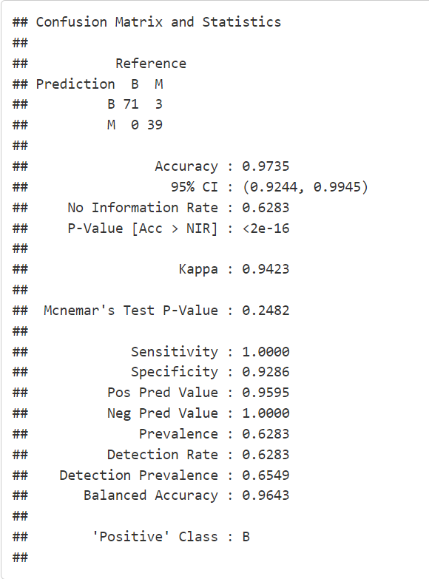
THE APPROACH
Decision Tree Model
KNN Model
The Classification techniques are used to solve the Breast Cancer problem
Decision Tree algorithm
KNN algorithm

Slide 4
The results
MODEL | RESULT
KNN ALGORITHM Accuracy Recall Precision | 97.23% 100% 92.86%
DECISION TREE ALGORITHM Accuracy Recall Precision | 91.15% 95.77% 83.33%
The KNN Model is the optimal model for this problem. It is the best model to use as it has higher accuracy than the Decision Tree Model. Hence, KNN Model is the right and optimal Model to use.

